Slide 1








A 2-days National Level Hackathon on
AI in education
AI-Powered GATE Study Buddy
Team Capstone
Bhuvan Patil
5th September 2025
SBJITMR , Yerla, Nagpur
www.samadhan.sistec.ac.in/

Slide 2


AREA OVERVIEW
Graduate Aptitude Test in Engineering is a National-level exam for admission to postgraduate programs (M.Tech, PhD) and for recruitment in PSUs (Public Sector Units).
AI brings personalized, bilingual, and 24×7 guidance to GATE aspirants, making exam preparation more efficient, inclusive, and adaptive to individual needs.
IMPORTANCE OF AREA
Many students prepare for GATE but face syllabus overload, lack of guidance, and language barriers — that’s why we chose this area to build an AI-powered study buddy that makes preparation smarter and inclusive.

Slide 3
Potential Challenges and Opportunities
Challenges:
Vast syllabus with complex technical concepts.
Limited access to personalized guidance in Tier-2/3 cities.
Lack of bilingual, concept-focused resources.
Difficulty in self-assessment, time management, and motivation.
Opportunities:
AI-powered adaptive tests and personalized learning paths.
Bilingual voice/text tutoring for wider accessibility.
Automated summaries, quizzes, and doubt resolution from multimedia inputs.
Real-time analytics and collaborative AI study rooms to boost engagement

Slide 4
Preliminary Solution Concept
We propose an AI-powered bilingual study buddy platform for GATE aspirants.
Students can interact via text or voice in Hindi/English.
AI processes multimedia inputs to generate summaries, flashcards, & questions.
An adaptive learning engine tracks progress and recommends weak topics.
In group study rooms, AI auto-summarizes discussions into concise notes.
Student can seamlessly continue test across devices without losing progress.
In short: An inclusive, always-available, and intelligent platform that reduces prep stress and improves efficiency for GATE aspirants.

Slide 5
Key Features and Functionalities
Bilingual Text + Voice Support for inclusive learning.
AI Adaptive Testing – auto-adjusts question difficulty.
Emotion-Aware Voice Tutor – supportive tone if student sounds stressed.
Cross-Device Sync – continue test seamlessly across devices.
Adaptive Mock Tests tailored to each student’s performance level.
Multimedia Input Support with AI summaries & quizzes.
Collaborative Study Rooms with AI-generated group notes.
Real-time Progress Dashboard showing strengths, weaknesses, and improvement.

Slide 6
Target Users and Expected Use Cases
Target Users
GATE Aspirants: Students from engineering backgrounds preparing for the exam.
Peer Groups: Friends or classmates who want collaborative study sessions.
Mentors/Teachers: Faculty or seniors who can guide and monitor progress
Expected Use Cases
A student uploads handwritten notes/PDF → AI generates summaries, quizzes, and flashcards
Aspirant asks a doubt in Hindi voice → AI explains in English with Hindi summary.
Group study session → AI creates structured notes and highlights common weak topics.

Slide 7
Data Requirements and Privacy Considerations
Data Requirements
Input Data: Student queries, notes, PDFs, videos, mock test responses.
System Data: Performance analytics, usage patterns, progress history.
Knowledge Base: Past GATE papers, standard textbooks, question banks.
Privacy Considerations
End-to-end encryption for chats, voice inputs, and uploaded files.
Role-based access to ensure only authorized users can view group data.
Consent-based storage of personal performance data processed.
Highlight any data privacy or security measures to protect user information in the selected sector.

Slide 8
AI Technologies and Methods
Natural Language Processing (NLP) – NLTK / Spacy
Machine Learning (ML) – scikit-learn, TensorFlow
Computer Vision (CV) - OpenCV
Large Language Models (LLMs) - OpenAI GPT / Gemini for tutoring, Whisper for speech.
Frontend: React.js (web), React Native (mobile), Tailwind CSS
Backend: Node.js + Express.js.
Database: MongoDB (user data), Pinecone/Weaviate (vector search).
Cloud: AWS/Azure for hosting.
Multi-Channel Platform Integration

Slide 9
Implementation Approach
Identify student pain points (syllabus overload, doubt resolution, progress tracking).
Map each pain point → AI-powered feature.
Build prototype using:
LLM (OpenAI/Gemini) for Q&A + explanations.
Whisper (speech-to-text) + TTS for bilingual voice tutor.
Vector DB for multimedia content search.
Realtime dashboards for analytics.

Slide 10
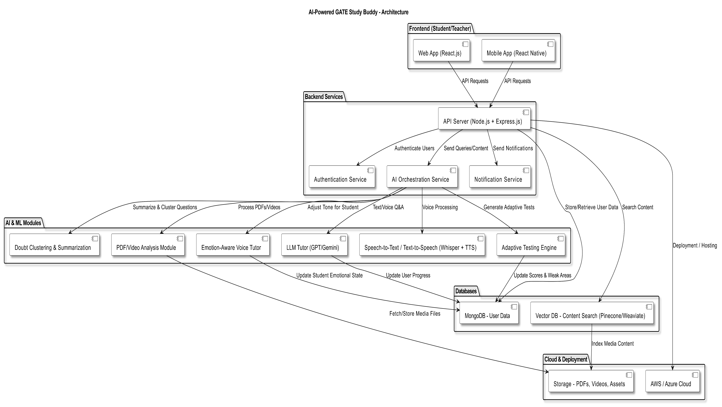

Slide 11
Expected Outcomes
Reduce prep stress via personalized guidance.
Increase efficiency through adaptive learning paths.
Promote bilingual inclusivity (Hindi + English).
Foster collaboration & peer learning at scale.
Scalable to other exams (JEE, CAT, NDA).

Slide 12
Evaluation Metrics
Accuracy: Correctness of AI answers & quiz generation.
Engagement: Daily active users, group study participation.
Learning Outcomes: Improvement in mock test scores & weak-topic mastery.
Response Time: Speed of AI query resolution (in sec).
User Satisfaction: Feedback ratings ≥ 4/5.
Collaboration Impact: Number of AI-generated group notes & discussions.

Slide 13
Future Plan
Impact at Scale:
Built to serve lakhs of students nationwide with cloud-ready architecture.
Future Plan:
Integrate official GATE question banks → authentic exam prep.
Mentor dashboards → personalized guidance.
Expand to other exams → CAT, JEE, UPSC, and more.
Vision:
From hackathon prototype → nationwide, real-world deployment.

Slide 14
“Making exam prep smarter, inclusive, and stress-free with AI.”
Thank You

